Slide 1
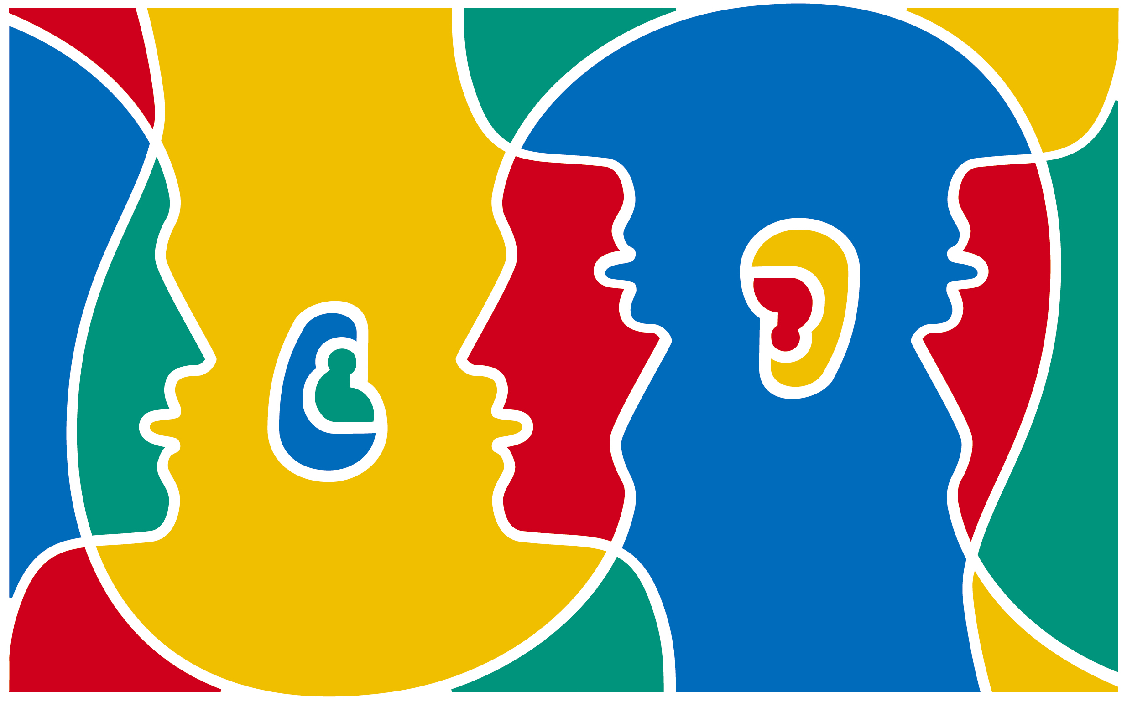
European Day of Languages 26.09.2012
Change your language!
Change ta langue!
Wechsel deine Sprache!
http://edl.ecml.at/tabid/1772/EventID/6341/Default.aspx

Slide 2
Let’s watch the EDL TV-spot!
European hellos
http://www.youtube.com/watch?feature=player_embedded&v=Fy7JjJMnKEg
Which languages can you identify?
Which person speaks French?

Slide 3
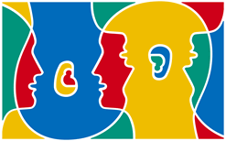
Why do we celebrate THE EUROPEAN DAY OF LANGUAGES ?
Well developed language skills are a necessity and a right for everyone
Linguistic diversity: Europe is rich in languages – there are over 200 European languages in daily use
Well developed language abilities allow people to take full advantage of the opportunities offered by modern societies
Learning other peoples' languages is another way of helping us to understand each other better and overcome our cultural differences
All this gives us reason to celebrate the richness and value of linguistic diversity in Europe!

Slide 4
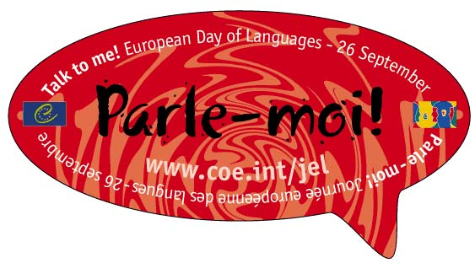
En français
Just like we use English now, other languages can become our „lingua franca“
(*a language systematically used to make communication possible between people not sharing a first language)
- Quelles sont les 5 choses auxquelles vous pensez quand je dis France?
What comes to your mind, when you think about France?

Slide 5
QUIZ
1. How many official and working languages does the European Union have?
34
45
23

Slide 6
QUIZ
2. Which language is the most widely spoken mother tongue in the EU ?
German
French
English

Slide 7
QUIZ
3. Which language is the most widely spoken language in the EU?
French
English
German

Slide 8
QUIZ
4. How many people in Europe speak French as their first language?
12%
18%
13%

Slide 9
QUIZ
5. How many people in Europe speak French as their second language?
38%
15%
14%

Slide 10
QUIZ
6. In which European countries French is spoken as an official language?
- Vatican
- Switzerland
- Belgium
- Austria
- Luxembourg
- Monaco
- Andorra
- Aosta Valley
- Channel Islands

Slide 11
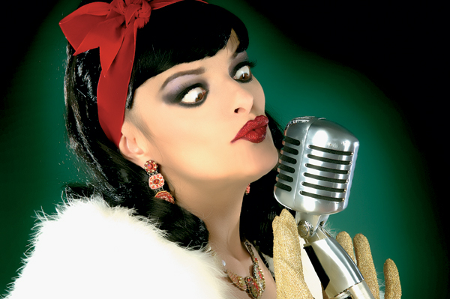
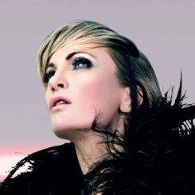
QUIZ
7. Which one is not French?
1
2
3

Slide 12
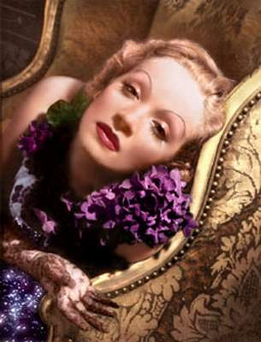
QUIZ
8. Which one is not German?
1 2 3

Slide 13
QUIZ
9. Write down as many French words that you know! (2 minutes)

Slide 14
QUIZ
10. Name as many French cities that you know. (2 minutes)

Slide 15
Let’s learn survival French!

Slide 16
Irie Revoltés a German band who sings in French

Slide 17
L'expression : je croise les doigts
How to wish to someone good luck in French and in German!
http://www.arte.tv/fr/l-expression-je-croise-les-doigts/6903122.html

Slide 18
Emprunts du coréen au français
빵 pain, 까페 café et 바게트 baguette
앙코르encore, 데뷔 début, 시네마 cinéma, 누벨 바그 nouvelle vague, 아방가르드 avant-garde
쿠데타coup d’État, 노블리스 오블리제 noblesse oblige, 프롤레타리아 prolétariat, et 레지스탕스 résistance
멜랑꼴리 mélancolie et 랑데 부 rendez-vous

Slide 19
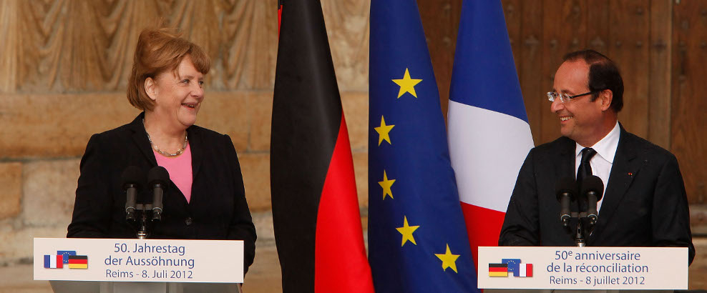
Cinquante ans d’amitié franco-allemande

Slide 20
If you want to know more…
About French culture:
http://www.france.or.kr/
About learning French in Korea:
http://www.afcoree.co.kr/
About travelling in France:
http://kr.franceguide.com/

